Slide 1
JOURNEY PPT
ANSUMAN NAYAK
ANSUMAN NAYAK
655475
INANJJ

Slide 2
WEEK 2 - AGENDA(GENERIC IDA)
Day 1 - Case study assessment (Foundation)
Day 2 - Data Fundamentals
Day 3 - Big data fundamentals and Azure fundamentals
Day 4 - Azure SQL database (Hands on)
Day 5 - Azure SQL database (Hands on)

Slide 3
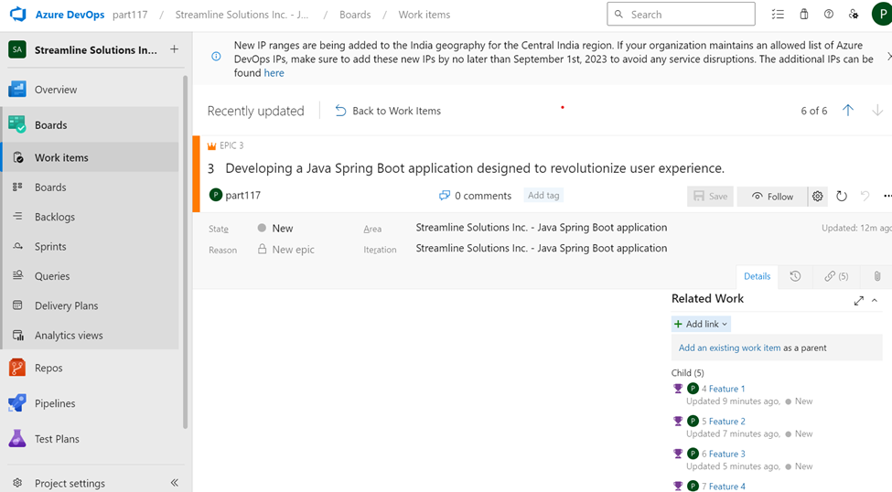
DAY – 7 (CASE STUDY ASSESSMENT)
AZURE BOARD ACTIVITIES

Slide 4
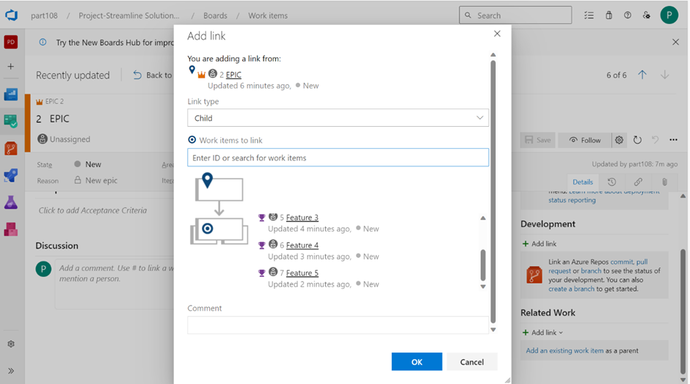
DAY – 7 (CASE STUDY ASSESSMENT)
AZURE BOARD ACTIVITIES

Slide 5
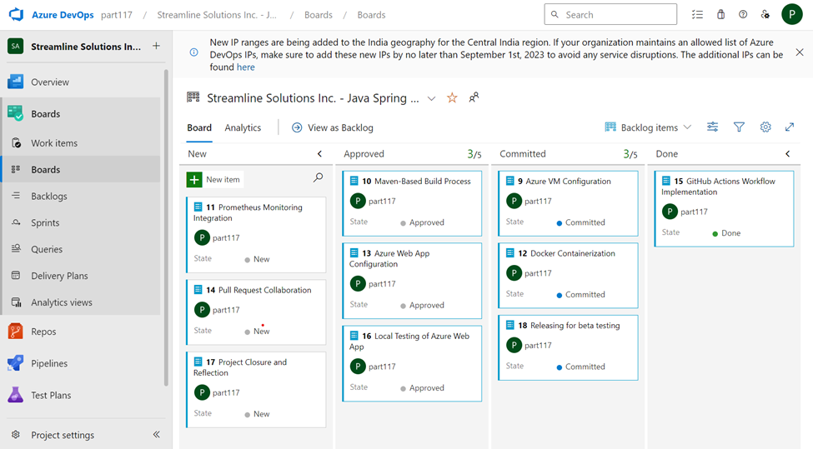
DAY – 7 (CASE STUDY ASSESSMENT)
AZURE BOARD ACTIVITIES

Slide 6
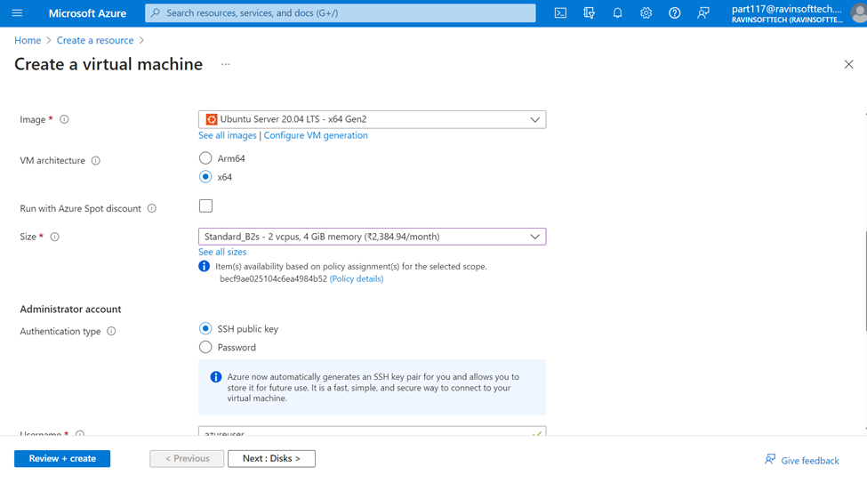
DAY – 7 (CASE STUDY ASSESSMENT)
CREATING AZURE VIRTUAL MACHINE

Slide 7
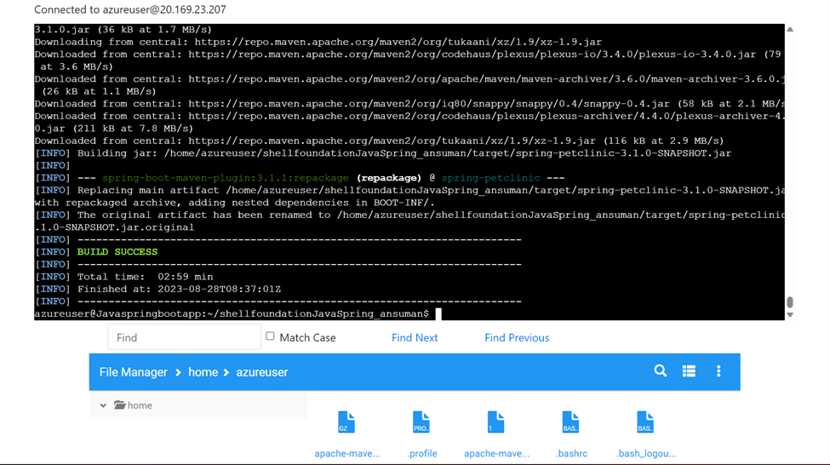
DAY – 7 (CASE STUDY ASSESSMENT)
MAVEN ACTIVITIES

Slide 8
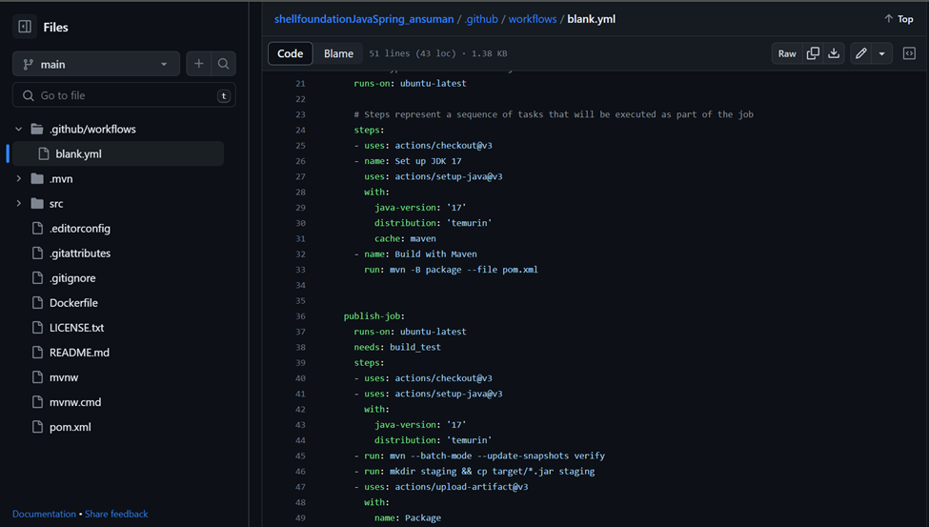
DAY – 7 (CASE STUDY ASSESSMENT)
GITHUB ACTIONS

Slide 9
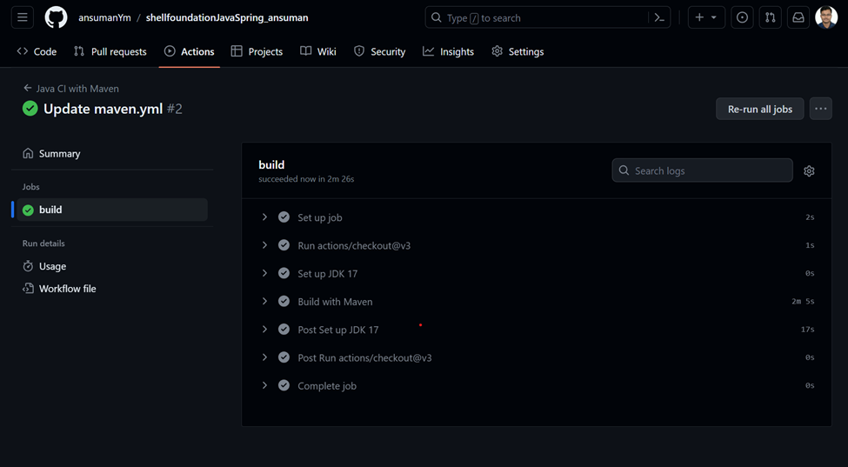
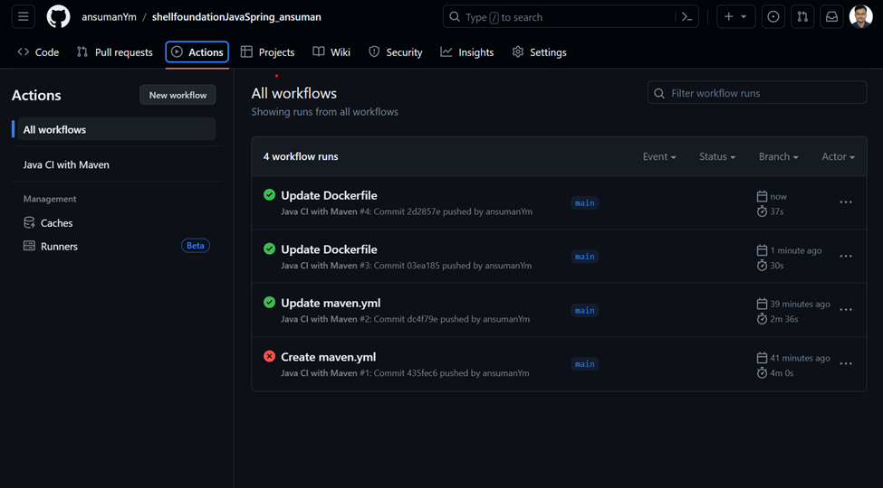
DAY – 7 (CASE STUDY ASSESSMENT)
GITHUB ACTIONS

Slide 10
DAY – 2 (DATA FUNDAMENTALS)
Introduction to DBMS: Types of data: Structured, unstructured, semi-structured.
Normalization and Denormalization.
Case study on ER Model
Dimensional Modelling concepts: Star schema, snowflake schema, SCD
DIMENSIONAL MODELING:
Dimensional Data Modeling is one of the data modeling techniques used in data warehouse design.
Since the main goal of this modeling is to improve the data retrieval so it is optimized for SELECT OPERATION.
The advantage of using this model is that we can store data in such a way that it is easier to store and retrieve the data once stored in a data warehouse.
Elements of Dimensional modeling: Facts, dimensions, attributes, fact table, dimension table

Slide 11
DAY – 2 (DATA FUNDAMENTALS)
STAR SCHEMA:
A star schema is a type of data modeling technique used in data warehousing to represent data in a structured and intuitive way. In a star schema, data is organized into a central fact table that contains the measures of interest, surrounded by dimension tables that describe the attributes of the measures.
In a star schema, each dimension table is joined to the fact table through a foreign key relationship. This allows users to query the data in the fact table using attributes from the dimension tables.
SNOWFLAKE SCHEMA:
The snowflake schema is a variant of the star schema.
Here, the centralized fact table is connected to multiple dimensions. In the snowflake schema, dimensions are present in a normalized form in multiple related tables.
The snowflake structure materialized when the dimensions of a star schema are detailed and highly structured, having several levels of relationship, and the child tables have multiple parent tables.
The snowflake effect affects only the dimension tables and does not affect the fact tables.

Slide 12
DAY – 2 (DATA FUNDAMENTALS)
SLOWLY CHANGING DIMENSION:
Slowly Changing Dimensions in Data Warehouse is an important concept that is used to enable the historic aspect of data in an analytical system. Slowly changing dimensions are important in data analytics to track how a record is changing over time.
It is used to track the changes made to attributes in dimension table.
Scd type1 - Changes old data with new data. No history is kept.
Scd type2 - Here we insert a new record with new changes. We don’t prefer empId or CustID as PK. We use the surrogate key as PK. History is preserved. 99% people prefer this.
Scd type3 - Adding a new column to the dimension table.

Slide 13
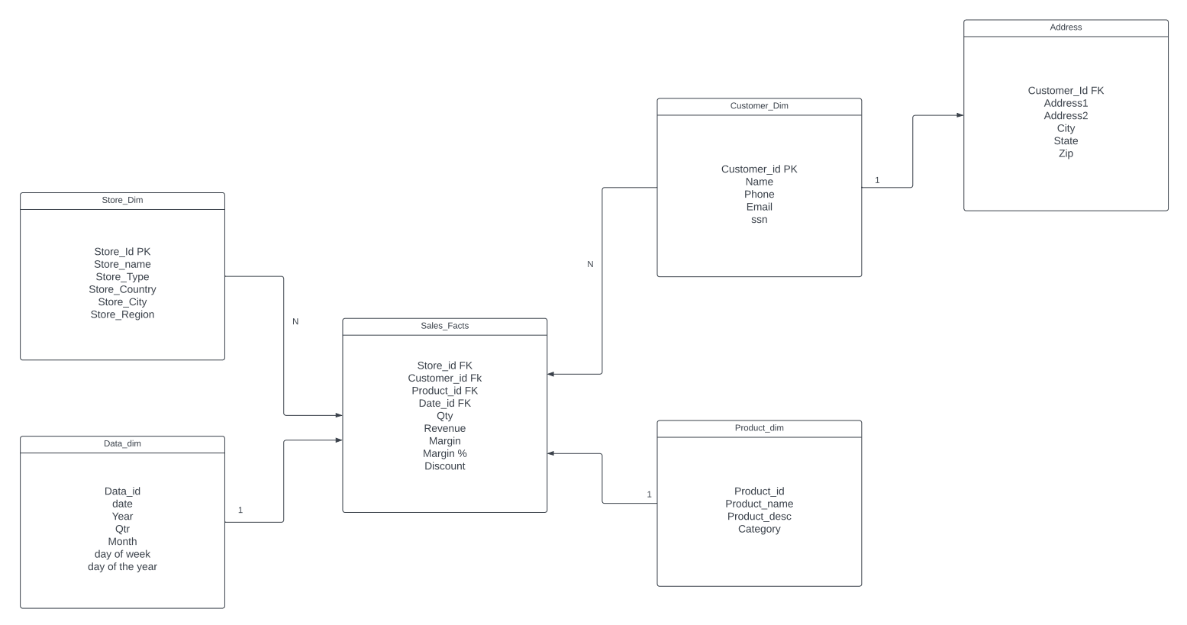
DAY – 2 (DATA FUNDAMENTALS)
Case study on ER Model

Slide 14
DAY – 3 (BIG DATA FUNDAMENTALS AND AZURE FUNDAMENTALS)
HADOOP and HADOOP ARCHITECHTURE:
Hadoop is an open-source software framework that is used for storing and processing large amounts of data in a distributed computing environment. It is designed to handle big data and is based on the MapReduce programming model, which allows for the parallel processing of large datasets.
Following are the components that collectively form a Hadoop ecosystem:
HDFS: Hadoop Distributed File System
YARN: Yet Another Resource Negotiator
MapReduce: Programming based Data Processing
Spark: In-Memory data processing
PIG, HIVE: Query based processing of data services
HBase: NoSQL Database
Zookeeper: Managing cluster

Slide 15
DAY – 4 (AZURE SQL 1)
CREATE TABLE students( id int,
student_name varchar(30),
address1 varchar(30),
city varchar(30))
sp_tables
sp_columns students
INSERT INTO students VALUES(1, 'Ram', 'Bellandur', 'Bengaluru')
INSERT INTO students VALUES(1, 'Shyam', 'null', 'Mumbai')
SELECT student_name, id FROM students
SELECT * INTO student1 FROM students -- Create new table from existing table with same structure
SELECT * FROM student1
SELECT * INTO students2 FROM students WHERE 1=5; -- Creating blank table from existing table
SELECT * FROM students2
INSERT INTO students2 SELECT * FROM students
SELECT * FROM students2
SELECT id, student_name INTO students3 FROM students;
SELECT * FROM students3;
SELECT id as student_id, student_name INTO students4 FROM students;
SELECT id, student_name INTO students5 FROM students WHERE 1 = 5
INSERT INTO students5 SELECT id,student_name FROM students
--SELECT * FROM students5;
CREATE TABLE student6(id int,
name varchar(30),
city varchar(30) default 'mumbai')
INSERT INTO student6(id, name) VALUES(1, 'ram')
INSERT INTO student6(id, name) VALUES(1, 'sham')
INSERT INTO student6 VALUES(1, 'kam', 'Bengaluru')
CREATE TABLE student7(id int identity(1,1), name varchar(30))
INSERT INTO student7(name) VALUES('ram');
INSERT INTO student7(name) VALUES('shyam');
INSERT INTO student7(name) VALUES('kaam');
--ALTER TABLE student7 ADD email varchar(30), phone varchar(30);
--ALTER TABLE student7 DROP column city;
sp_rename 'student7.name' , student_name, 'column'
SELECT * FROM student7

Slide 16
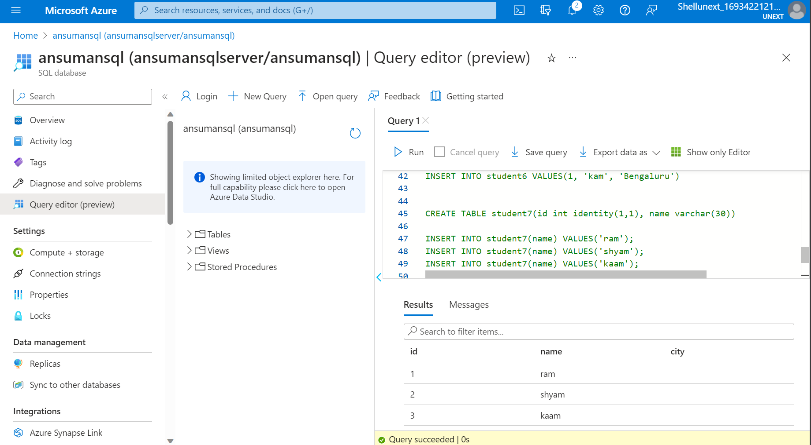
DAY – 4 (AZURE SQL 1)

Slide 17
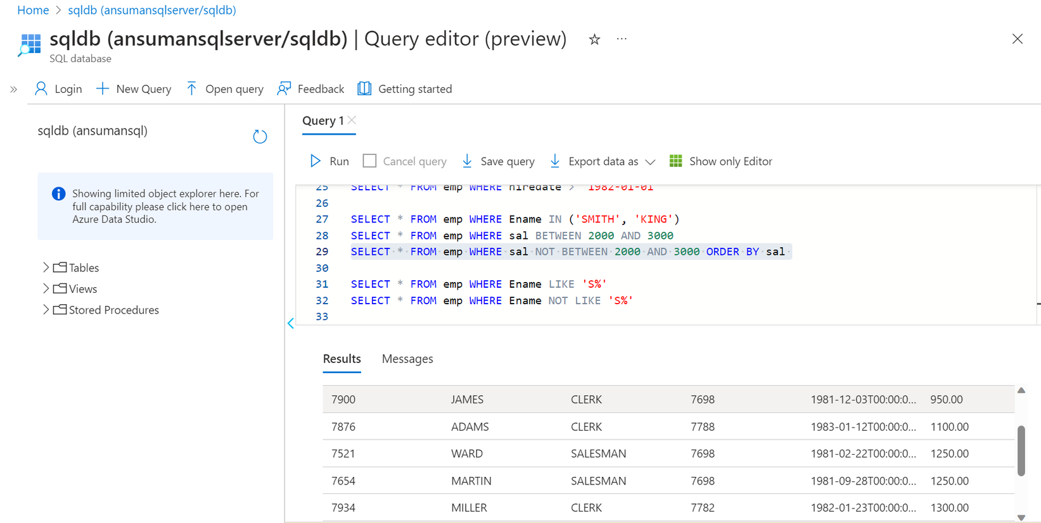
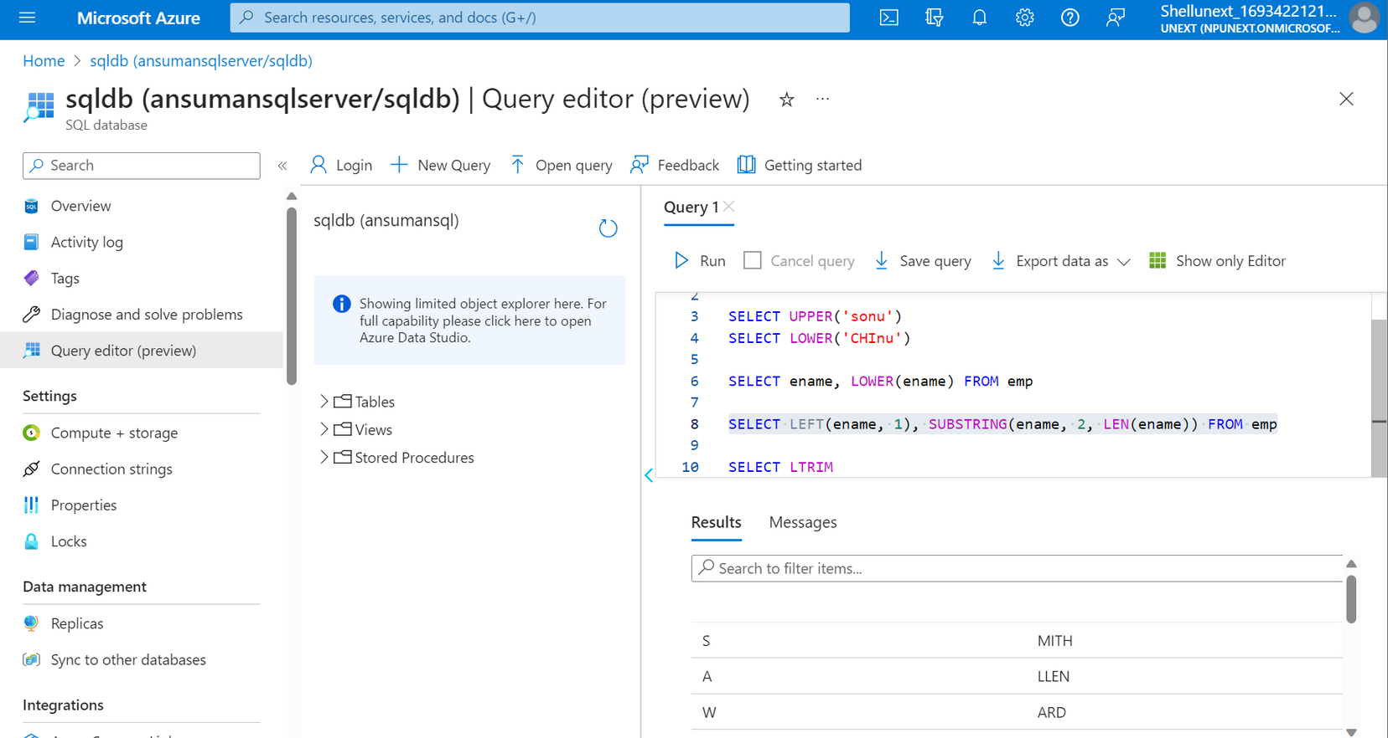
DAY – 4 (AZURE SQL 1)

Slide 18
DAY – 5 (AZURE SQL 2)
SELECT * FROM emp
SELECT * FROM emp ORDER BY ename
SELECT * FROM emp ORDER BY ename desc
SELECT * FROM emp ORDER BY deptno, sal DESC
SELECT count(*) AS NoOFRECORDS FROM emp
SELECT COUNT(comm) as noofcomm FROM emp
SELECT deptno FROM emp
SELECT top 5 * FROM emp ORDER BY sal DESC
SELECT * FROM emp WHERE Ename = 'SMITH'
SELECT * FROM emp WHERE Ename != 'SMITH'
SELECT * FROM emp WHERE Ename <> 'SMITH'
SELECT * FROM emp WHERE sal > 3000
SELECT * FROM emp WHERE sal >= 3000
SELECT * FROM emp WHERE sal < 3000
SELECT * FROM emp WHERE sal <= 3000
SELECT * FROM emp WHERE hiredate > '1982-01-01'
SELECT * FROM emp WHERE Ename IN ('SMITH', 'KING')
SELECT * FROM emp WHERE sal BETWEEN 2000 AND 3000
SELECT * FROM emp WHERE sal NOT BETWEEN 2000 AND 3000 ORDER BY sal
SELECT * FROM emp WHERE Ename LIKE 'S%'
SELECT * FROM emp WHERE Ename NOT LIKE 'S%'
FUNCTIONS
-----------------------------------------------------------------------------
SINGLE ROW FUNCTIONS
- String function
- Number function
- Date function
SELECT ASCII('B')
SELECT ename, LEN(ename) FROM emp
SELECT ename, LEN(ename) FROM emp WHERE LEN(ename) > 5
SELECT ename, CONCAT('Hi ', ename) as welmessage FROM emp
SELECT ename, CONCAT_WS(' ','Hi', ename, 'how are you') as welmessage FROM emp ---- CONCAT_WS means with space
SELECT ename, LEFT(ename, 3) FROM emp
SELECT ename, RIGHT(ename, 3) FROM emp
SELECT ename, SUBSTRING(ename, 2,2) FROM emp -- Starting chaarecter, number of characters
SELECT UPPER('sonu')
SELECT LOWER('CHInu')
SELECT ename, LOWER(ename) FROM emp
SELECT UPPER(LEFT(ename, 1)), LOWER(SUBSTRING(ename, 2, LEN(ename))) FROM emp
SELECT CONCAT(UPPER(LEFT(ename, 1)), LOWER(SUBSTRING(ename, 2, LEN(ename)))) FROM emp
SELECT LEN(LTRIM(' chinu'))
SELECT LEN(' chinu ')
SELECT len(ltrim(RTRIM(' chinu ')))
SELECT TRIM(' chinu ')
SELECT LEN(TRIM(' chinu '))
SELECT EXP(1)
SELECT comm, ISNULL(0,comm) comm FROM emp
SELECT NULLIF(ename, 'SMITH') ename_o FROM emp
SELECT sal, IIF(sal> 3000, 'Good sal', IIF(sal> 2000, 'Avg sal', 'POOR')) sal_descrip FROM emp

Slide 19
DAY – 5 (AZURE SQL 2)
JOINS : INNER JOIN, LEFT OUTER JOIN, RIGHT OUTER JOIN,
---------------------------------------------------------------------------------------------------
INSERT INTO emp VALUES(1, 'babjee', 'IT', 7902, getdate(), 4000, 0,70)
INSERT INTO emp VALUES(2, 'Naveen', 'IT', 7902, getdate(), 4000, 0,70)
INSERT INTO dept VALUES(40, 'Operation', 'Bostan')
SELECT empno, ename, sal, emp, e.deptno, dname, loc FROM emp e
INNER JOIN dept d
on e.deptno = d.deptno
SELECT empno, ename, sal, e.deptno, dname, loc FROM emp e
INNER JOIN dept d
on e.deptno = d.deptno
SELECT empno, ename, sal, e.deptno, dname, loc FROM emp e
LEFT JOIN dept d
on e.deptno = d.deptno
SELECT empno, ename, sal, e.deptno, dname, loc FROM emp e
RIGHT JOIN dept d
on e.deptno = d.deptno
SELECT ename, sal FROM emp ORDER BY sal desc LIMIT 1
SELECT e.empno, e.ename, e.mgr, m.ename as managername
from emp e JOIN emp m on e.mgr = m.empno
NON EQUI JOIN
---------------------------------------------------------------------------------------------------
SELECT empno, ename, sal, grade FROM emp e JOIN salgrade s ON e.sal BETWEEN s.losal AND s.hisal
-----------------------------------------------------------------------------------------------
SUBQUERIES
----------------------------------------------------------------------------------------------------
SELECT sal FROM emp WHERE ename = 'SMITH'
SELECT * FROM emp WHERE sal > (SELECT sal FROM emp WHERE ename = 'SMITH')
SELECT * FROM emp WHERE sal > (SELECT AVG(sal) FROM emp )
SELECT * FROM emp WHERE sal = (SELECT MAX(sal) FROM emp )
SELECT * FROM dept WHERE deptno IN (SELECT DISTINCT deptno FROM emp)
SELECT * FROM dept WHERE deptno NOT IN (SELECT DISTINCT deptno FROM emp)
SELECT * FROM emp o WHERE sal > (SELECT AVG(sal) FROM emp i WHERE o.deptno = i.deptno)
SELECT SUM(sal) as sum_sal, MAX(sal) as max_sal, MIN(sal) as min_sal, AVG(sal) as avg_sal, COUNT(sal) as noofrecords
FROM emp e JOIN dept d ON e.deptno = d.deptno
SELECT dname, SUM(sal) as sum_sal, MAX(sal) as max_sal, MIN(sal) as min_sal, AVG(sal) as avg_sal, COUNT(sal) as noofrecords
FROM emp e JOIN dept d ON e.deptno = d.deptno GROUP BY dname
BEGIN TRANSACTION
INSERT INTO COLORA VALUES ('BLACK')
DELETE FROM COLORA WHERE col1 = 'BLUE'
COMMIT transaction
ROLLBACK TRANSACTION
CREATE VIEW emp_view AS SELECT * FROM emp;
SELECT * FROM emp_view
DROP VIEW emp_view

Slide 20
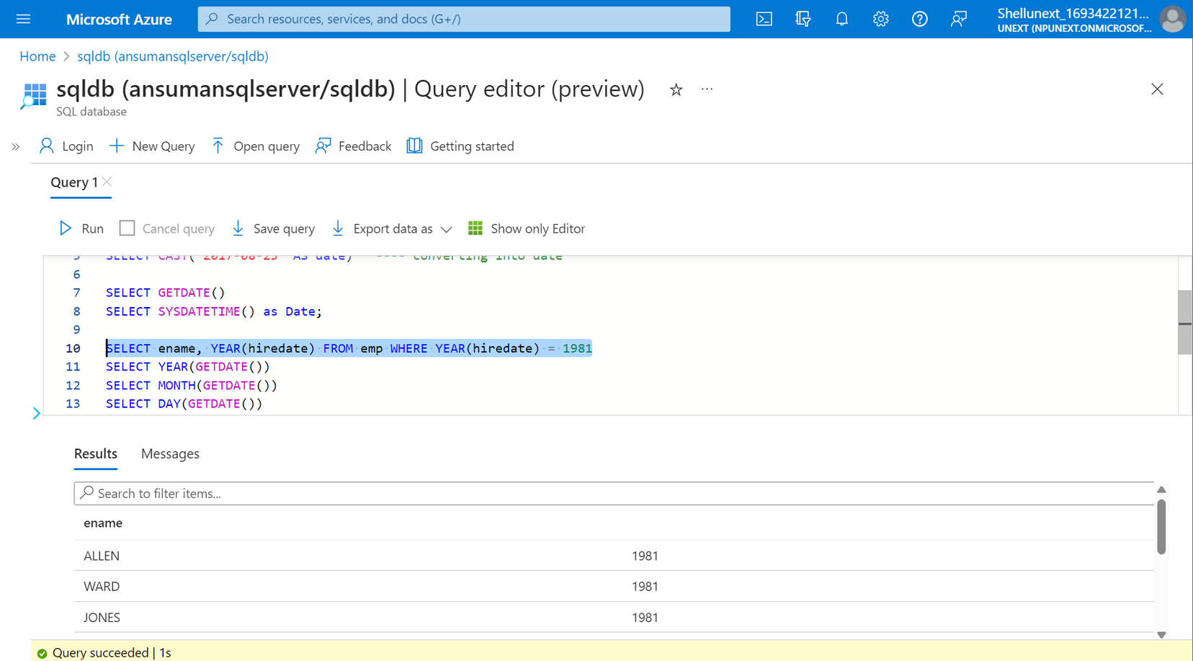
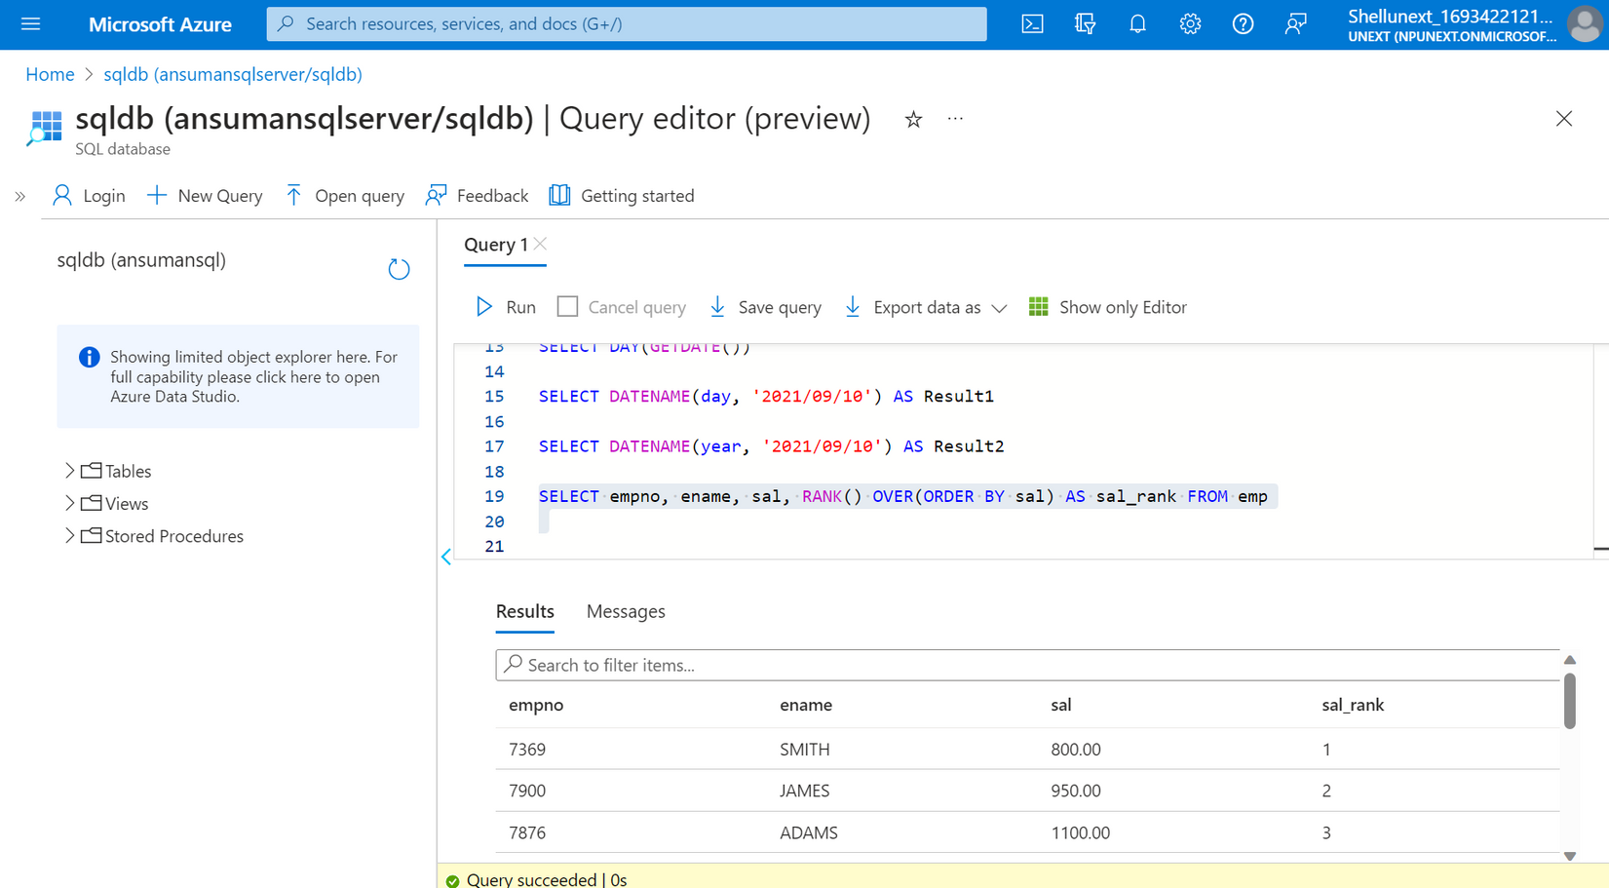
DAY – 5 (AZURE SQL 2)

Slide 21

Thank you!
NEW BUSINESS OPPORTUNITY
Henrietta Mitchell, Founder & CEO
Matt Zhang, Founder & CTO
13 September, 2023
Ingoude Company

